Slide 1





250 Northern Ave, Boston, MA 02210
Phone: 844-448-1212
Email: info@rstudio.com Web: http://www.rstudio.com
All Training materials are provided "as is" and without warranty and RStudio disclaims any and all express and implied warranties including without limitation the implied warranties of title, fitness for a particular purpose, merchantability and noninfringement.
The Training Materials are licensed under the Creative Commons Attribution-Noncommercial 3.0 United States License. To view a copy of this license, visithttp:// creativecommons.org/licenses/by-nc/3.0/us/ or send a letter to Creative Commons, 171 Second Street, Suite 300, San Francisco, California, 94105, USA.
© 2014 RStudio, Inc. All rights reserved. Follow @rstudioapp
CC by RStudio 2015
Follow @rstudio

Slide 2










Studio
250 Northern Ave, Boston, MA 02210
Phone: 844-448-1212
Email: info@rstudio.com Web: http://www.rstudio.com
How to start
with Shiny, Part 2
How to customize reactions
Garrett Grolemund
Data Scientist and Master Instructor May 2015
Email: garrett@rstudio.com Twitter: @StatGarrett
CC by RStudio 2015
Follow @rstudio

Slide 3
Slides at: bit.ly/shiny-quickstart-2
Code and slides at:
bit.ly/shiny-quickstart-2

Slide 4

Slides at: bit.ly/shiny-quickstart-2
Shiny Showcase
www.rstudio.com/products/ shiny/shiny-user-showcase/

Slide 5
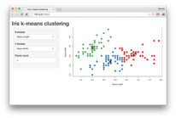



How to start with Shiny
Slides at: bit.ly/shiny-quickstart-2
How to build a Shiny app (www.rstudio.com/resources/webinars/)
How to customize reactions (Today)
How to customize appearance

Slide 6
The story so far

Slide 7
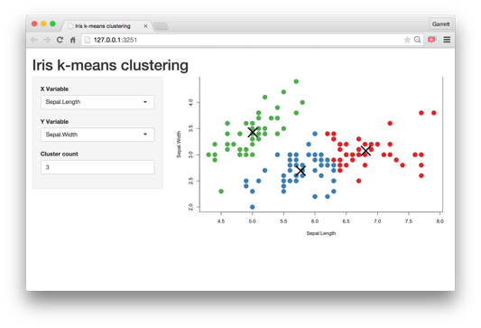
Slides at: bit.ly/shiny-quickstart-2
Every Shiny app is maintained by a computer running R

Slide 8
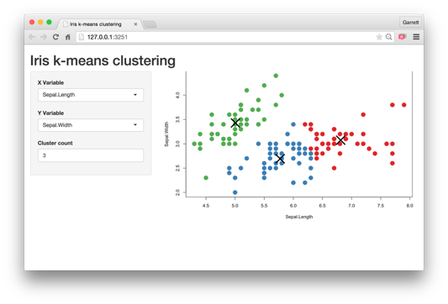



App template
Slides at: bit.ly/shiny-quickstart-2
The shortest viable shiny app
library(shiny) ui <- fluidPage()
server <- function(input, output) {} shinyApp(ui = ui, server = server)

Slide 9
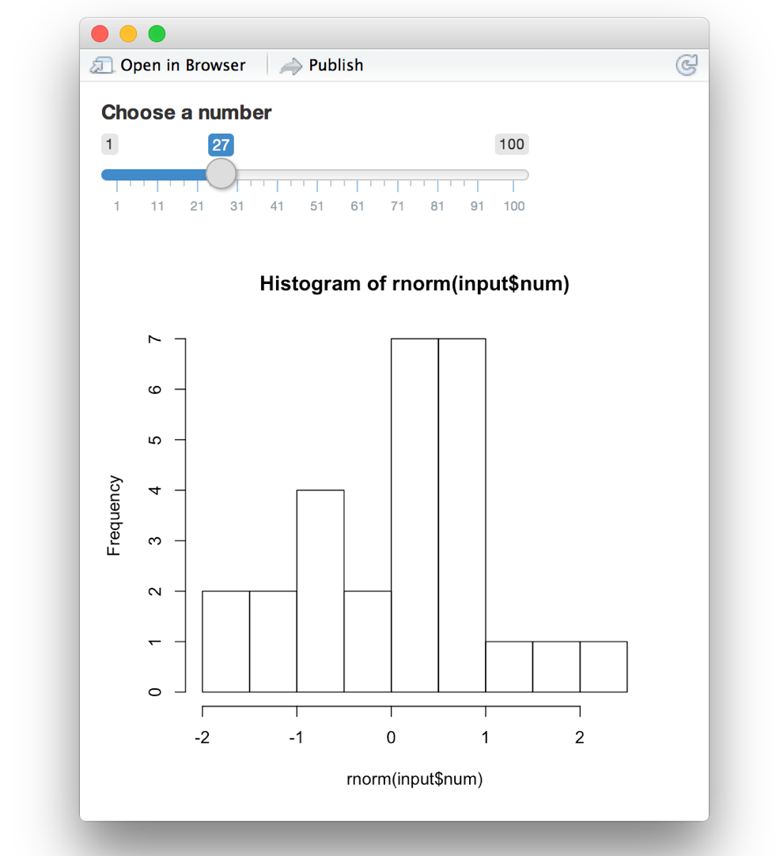
library(shiny)
ui <- fluidPage(
)
server <- function(input, output) {
}
shinyApp(ui = ui, server = server)

Slide 10
library(shiny)
ui <- fluidPage(
sliderInput(inputId = "num", label = "Choose a number", value = 25, min = 1, max = 100)
)
server <- function(input, output) {
}
shinyApp(ui = ui, server = server)

Slide 11
library(shiny)
ui <- fluidPage( sliderInput(inputId = "num",
label = "Choose a number", value = 25, min = 1, max = 100),
plotOutput("hist")
)
* Output() adds a space in the ui for an R object.
You must build the object in the server function
server <- function(input, output) {
}
shinyApp(ui = ui, server = server)

Slide 12
library(shiny)
ui <- fluidPage( sliderInput(inputId = "num",
label = "Choose a number", value = 25, min = 1, max = 100),
plotOutput("hist")
)
server <- function(input, output) {
output$hist <-
1
}
shinyApp(ui = ui, server = server)

Slide 13
library(shiny)
ui <- fluidPage( sliderInput(inputId = "num",
label = "Choose a number", value = 25, min = 1, max = 100),
plotOutput("hist")
)
server <- function(input, output) { output$hist <- renderPlot({
2
})
}
shinyApp(ui = ui, server = server)

Slide 14
library(shiny)
ui <- fluidPage( sliderInput(inputId = "num",
label = "Choose a number", value = 25, min = 1, max = 100),
plotOutput("hist")
)
server <- function(input, output) { output$hist <- renderPlot({
hist(rnorm(input$num))
})
3
}
shinyApp(ui = ui, server = server)

Slide 15
library(shiny)
ui <- fluidPage( sliderInput(inputId = "num",
label = "Choose a number", value = 25, min = 1, max = 100),
plotOutput("hist")
)
server <- function(input, output) { output$hist <- renderPlot({
hist(rnorm(input$num))
})
}
shinyApp(ui = ui, server = server)

Slide 16
What is Reactivity?

Slide 17
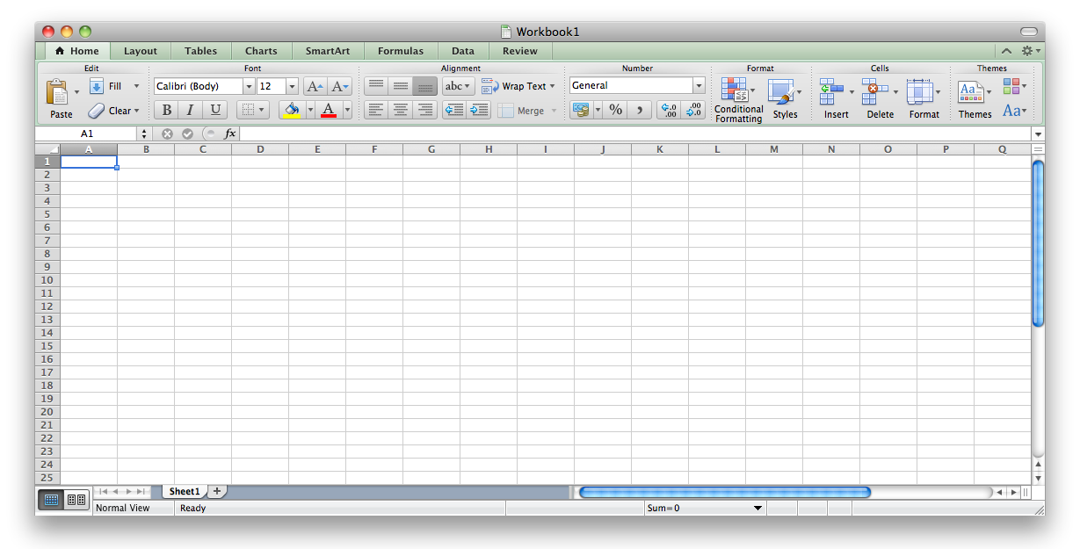
Slides at: bit.ly/shiny-quickstart-2
Think Excel.

Slide 18
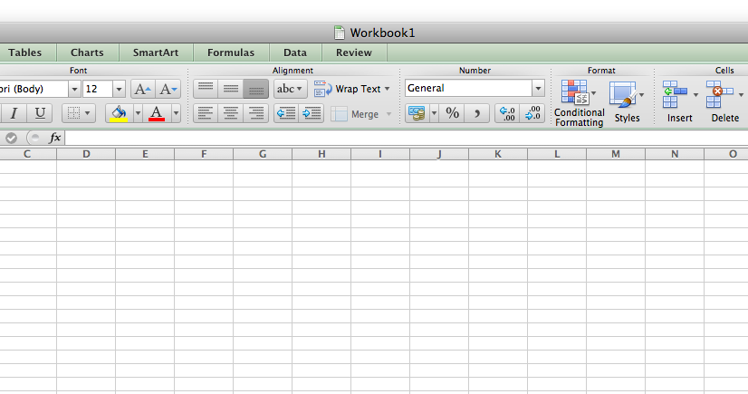
Slides at: bit.ly/shiny-quickstart-2
50 |  |  |  | = F4 + 1

Slide 19
Slides at: bit.ly/shiny-quickstart-2
50
51

Slide 20
Slides at: bit.ly/shiny-quickstart-2
50
101
 | 100
51

Slide 21
Slides at: bit.ly/shiny-quickstart-2
100
1000
 | 999
101

Slide 22
Slides at: bit.ly/shiny-quickstart-2
999
1001
 | 1000
1000

Slide 23
Slides at: bit.ly/shiny-quickstart-2
999
1001
 | 1000
1000
input$x
output$y

Slide 24
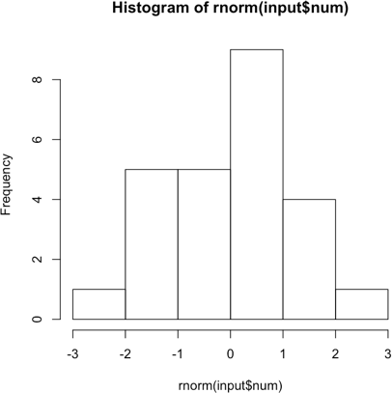

Slides at: bit.ly/shiny-quickstart-2
run(this)
input$x
output$y

Slide 25
Slides at: bit.ly/shiny-quickstart-2
run(this)
input$x
expression(o)utput$y

Slide 26

Slides at: bit.ly/shiny-quickstart-2
run(this)
input$x
expression()
output$y
Update

Slide 27
Begin with
reactive values

Slide 28
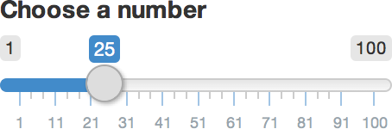


Syntax
Slides at: bit.ly/shiny-quickstart-2
sliderInput(inputId = "num", label = "Choose a number", …)
this input will provide a value saved as input$num

Slide 29
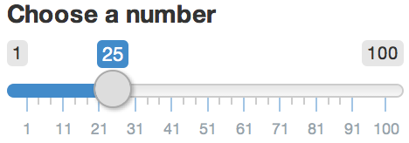
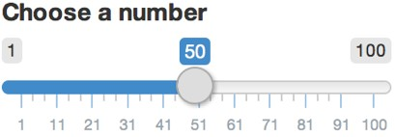
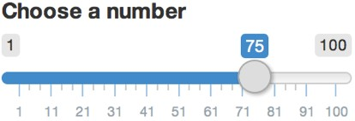
Slides at: bit.ly/shiny-quickstart-2
Input values
The input value changes whenever a user changes the input.
input$num = 2
5
0
input$num = 5
5
input$num = 7

Slide 30
Reactive values work together with reactive functions. You cannot call a reactive value from outside of one.
Slides at: bit.ly/shiny-quickstart-2
$
renderPlot({ hist(rnorm(100, input$num)) })
#
hist(rnorm(100, input$num))

Slide 31
library(shiny)
ui <- fluidPage( sliderInput(inputId = "num",
label = "Choose a number", value = 25, min = 1, max = 100),
plotOutput("hist")
)
server <- function(input, output) { output$hist <- renderPlot({
hist(rnorm(input$num))
})
}
shinyApp(ui = ui, server = server)

Slide 32
library(shiny)
ui <- fluidPage( sliderInput(inputId = "num",
label = "Choose a number", value = 25, min = 1, max = 100),
plotOutput("hist")
)
server <- function(input, output) { output$hist <- renderPlot({
hist(rnorm(input$num))
})
}
shinyApp(ui = ui, server = server)

Slide 33
library(shiny)
Error in .getReactiveEnvironment()
$currentContext() :
Operation not allowed without an active reactive context. (You tried to do something that can only be done from inside a reactive expression or observer.)
ui <- fluidPage( sliderInput(inputId = "num",
label = "Choose a number", value = 25, min = 1, max = 100),
plotOutput("hist")
)
server <- function(input, output) { output$hist <-
hist(rnorm(input$num))
}
shinyApp(ui = ui, server = server)

Slide 34
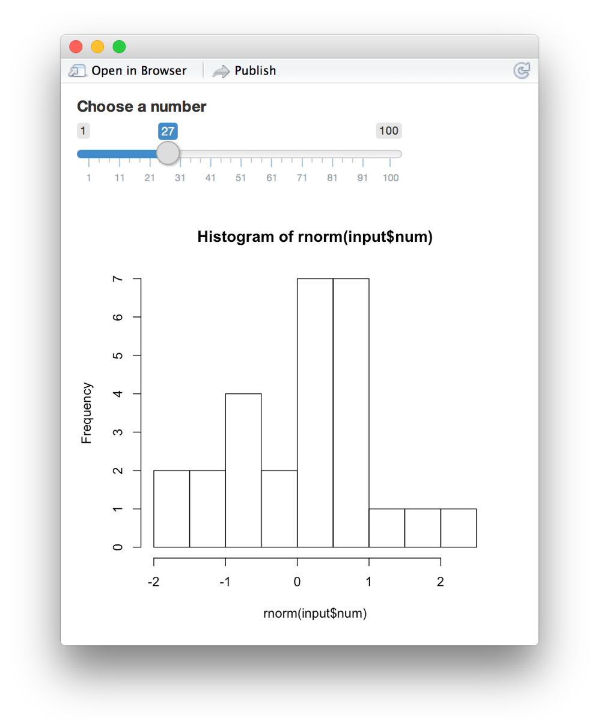
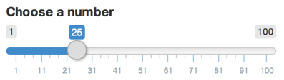
Think of reactivity in R as a two step process
1 Reactive values notify
the functions that use them when they become invalid
input$num
output$hist <- renderPlot({ hist(rnorm(input$num))
})

Slide 35
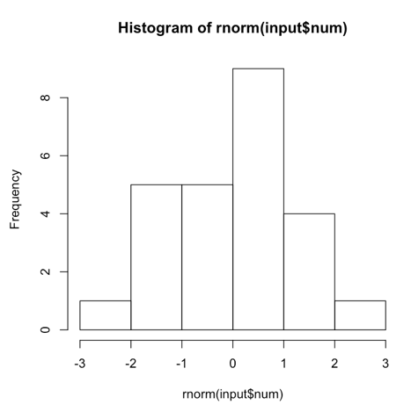
Think of reactivity in R as a two step process
1 Reactive values notify
the functions that use them when they become invalid
input$num
₂ The objects created by
reactive functions respond
(diﬀerent objects respond diﬀerently)
output$hist <- renderPlot({ hist(rnorm(input$num))
})

Slide 36


Slides at: bit.ly/shiny-quickstart-2
Recap: Reactive values
Reactive values act as the data
run(this)
input$x
expression()
output$y
streams that flow through your app.
Update
The input list is a list of reactive values. The values show the current state of the inputs.
input$num = 25
#
You can only call a reactive value from a function that is designed to work with one
input$num
Reactive values notify. The objects created by reactive functions respond.
output$hist

Slide 37
Reactive toolkit
(7 indispensible functions)

Slide 38
Reactive functions
Slides at: bit.ly/shiny-quickstart-2
1
Use a code chunk to build (and rebuild) an object
What code will the function use?
₂ The object will respond to changes in a set of
reactive values
Which reactive values will the object respond to?

Slide 39
Display output with render*()

Slide 40


Slides at: bit.ly/shiny-quickstart-2
Render functions build output to display in the app
function creates
renderDataTable() | _{An interactive table} (from a data frame, matrix, or other table-like structure)
renderImage() | An image (saved as a link to a source file)
renderPlot() | A plot
renderPrint() | A code block of printed output
renderTable() | _{A table} (from a data frame, matrix, or other table-like structure)
renderText() | A character string
renderUI() | a Shiny UI element

Slide 41
render*()
Builds reactive output to display in UI
Slides at: bit.ly/shiny-quickstart-2
renderPlot( { hist(rnorm(input$num)) })
object will respond to every reactive value in the code
code used to build (and rebuild) object

Slide 42
render*()
Builds reactive output to display in UI
Slides at: bit.ly/shiny-quickstart-2
renderPlot( { hist(rnorm(input$num)) })
When notified that it is invalid, the object created by a render*() function will rerun the entire block of code associated with it

Slide 43
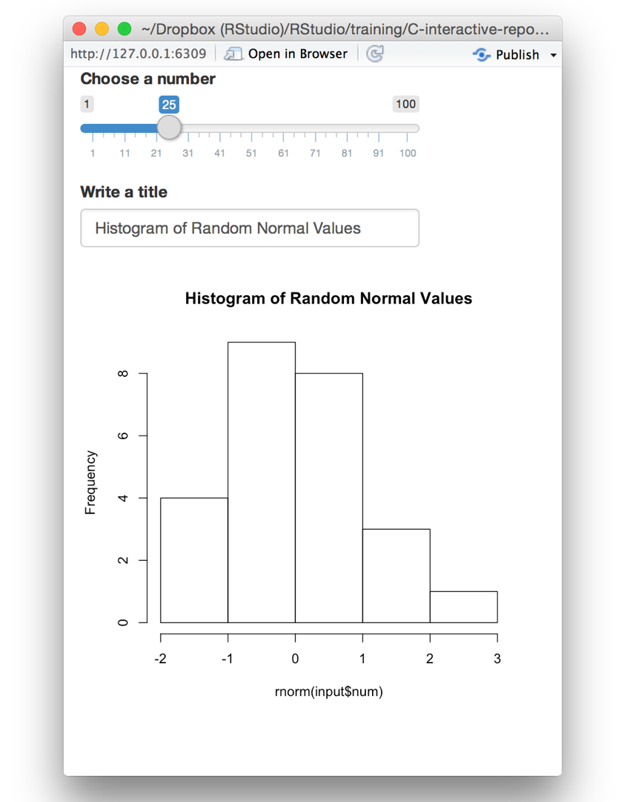
# 01-two-inputs
library(shiny) ui <- fluidPage(
sliderInput(inputId = "num", label = "Choose a number",
value = 25, min = 1, max = 100), textInput(inputId = "title",
label = "Write a title",
value = "Histogram of Random Normal Values"), plotOutput("hist")
)
server <- function(input, output) { output$hist <- renderPlot({
hist(rnorm(input$num), main = input$title)
})
}
shinyApp(ui = ui, server = server)

Slide 44
# 01-two-inputs
library(shiny) ui <- fluidPage(
sliderInput(inputId = "num", label = "Choose a number",
value = 25, min = 1, max = 100), textInput(inputId = "title",
label = "Write a title",
value = "Histogram of Random Normal Values"), plotOutput("hist")
)
server <- function(input, output) { output$hist <- renderPlot({
hist(rnorm(input$num), main = input$title)
})
}
shinyApp(ui = ui, server = server)

Slide 45

input$num
input$title
output$hist <- renderPlot({ hist(rnorm(input$num),
main = input$title)
})

Slide 46
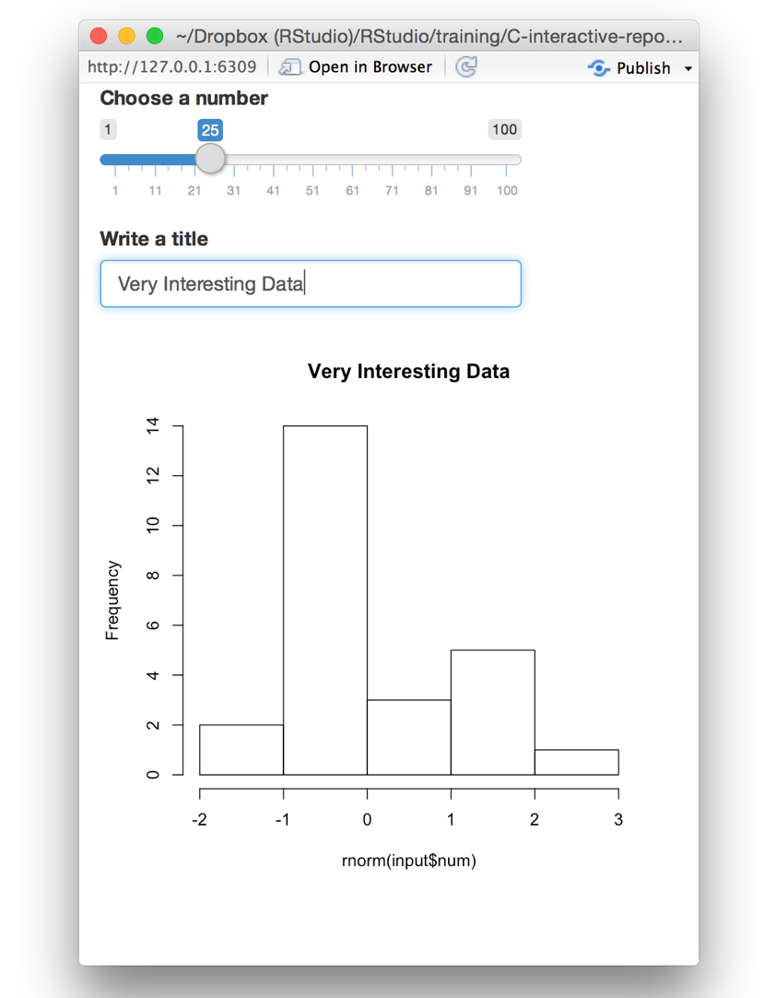
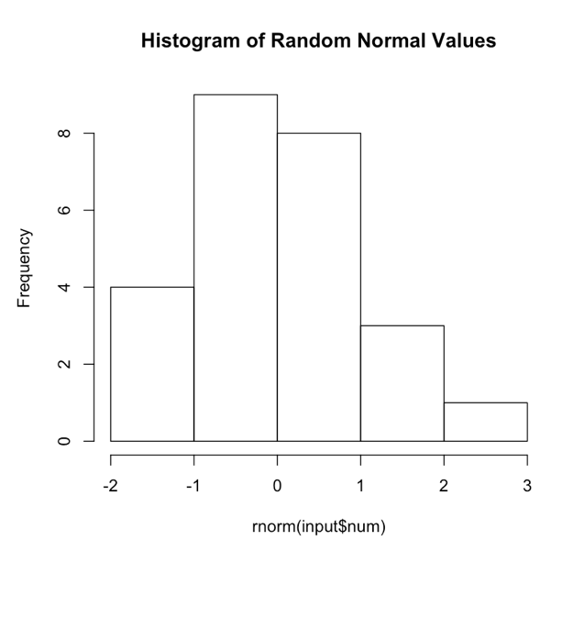
input$num
input$title
output$hist <- renderPlot({ hist(rnorm(input$num),
main = input$title)
})

Slide 47
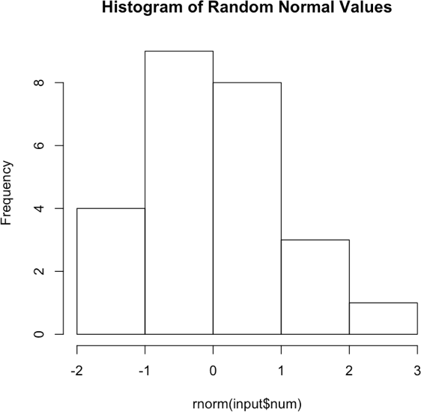
Slides at: bit.ly/shiny-quickstart-2
Recap: render*()
render*() functions make objects to display
output$
Always save the result to output$
render*() makes an observer object that has a
block of code associated with it
output$hist <- renderPlot({ hist(rnorm(input$num),
main = input$title)
})
The object will rerun the entire code block
to update itself whenever it is invalidated
renderPlot( { hist(rnorm(input$num)) })

Slide 48
Modularize code with reactive()

Slide 49
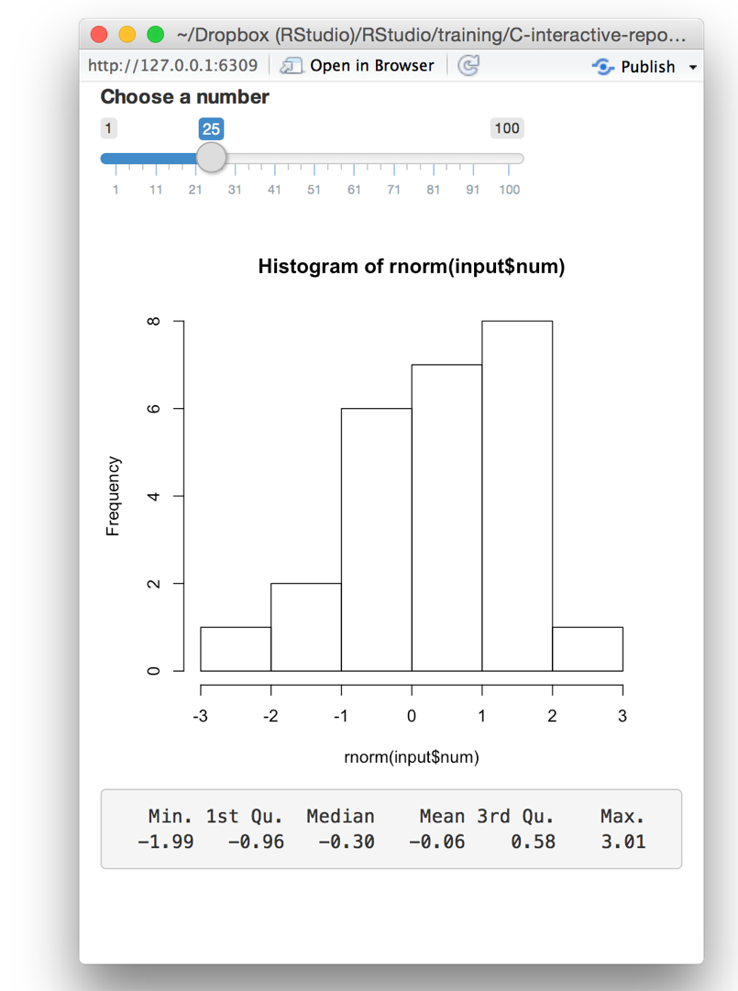
# 02-two-outputs
library(shiny) ui <- fluidPage(
sliderInput(inputId = "num", label = "Choose a number",
value = 25, min = 1, max = 100), plotOutput("hist"), verbatimTextOutput("stats")
)
server <- function(input, output) { output$hist <- renderPlot({
hist(rnorm(input$num))
})
output$stats <- renderPrint({ summary(rnorm(input$num))
})
}
shinyApp(ui = ui, server = server)

Slide 50
# 02-two-outputs
library(shiny) ui <- fluidPage(
sliderInput(inputId = "num", label = "Choose a number",
value = 25, min = 1, max = 100), plotOutput("hist"), verbatimTextOutput("stats")
)
server <- function(input, output) { output$hist <- renderPlot({
hist(rnorm(input$num))
})
output$stats <- renderPrint({ summary(rnorm(input$num))
})
}
shinyApp(ui = ui, server = server)

Slide 51
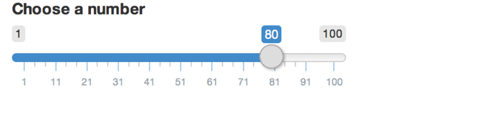
input$num
output$hist <-
renderPlot({ hist(rnorm(input$num))
})
output$stats <- renderPrint({ summary(rnorm(input$num))
})

Slide 52
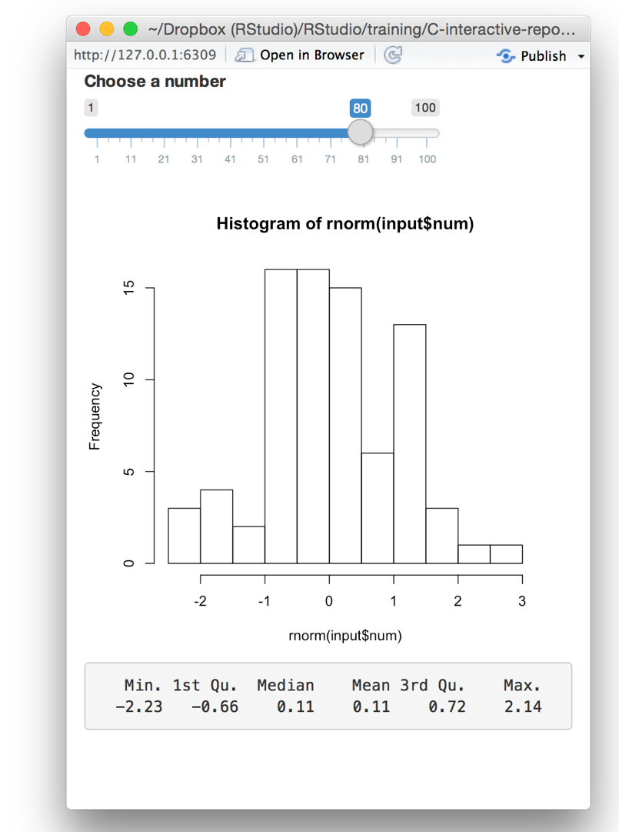
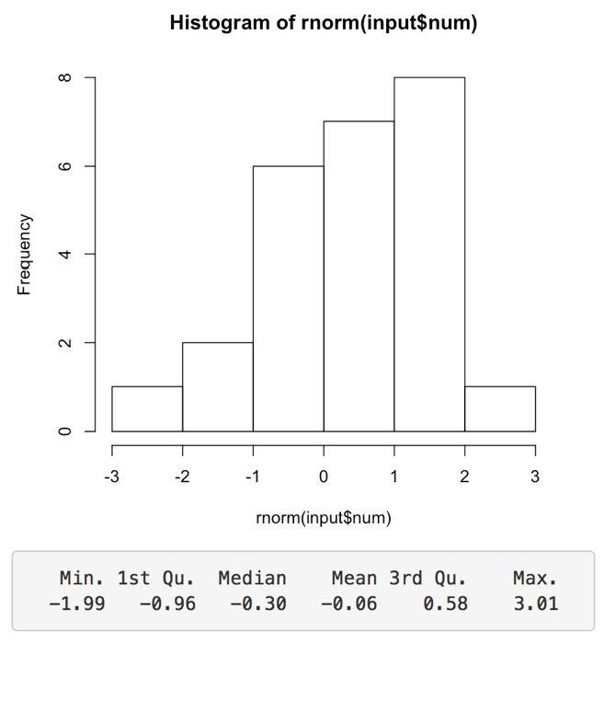
input$num
output$hist <-
renderPlot({ hist(rnorm(input$num))
})
output$stats <- renderPrint({ summary(rnorm(input$num))
})

Slide 53
input$num
Can these describe the same data?
output$hist <-
renderPlot({ hist(rnorm(input$num))
})
output$stats <- renderPrint({ summary(rnorm(input$num))
})

Slide 54
input$num
data <-? rnorm(input$num)
output$hist <- renderPlot({ hist(data)
})
output$stats <- renderPrint({ summary(data)
})

Slide 55
reactive()
Slides at: bit.ly/shiny-quickstart-2
Builds a reactive object (reactive expression)
data <- reactive( { rnorm(input$num) })
object will respond to every reactive value in the code
code used to build (and rebuild) object

Slide 56
A reactive expression is special in two ways
Slides at: bit.ly/shiny-quickstart-2
data()
1
You call a reactive expression like a function

Slide 57
# 02-two-outputs
library(shiny) ui <- fluidPage(
sliderInput(inputId = "num",
label = "Choose a number",
value = 25, min = 1, max = 100), plotOutput("hist"), verbatimTextOutput("stats")
)
server <- function(input, output) {
output$hist <- renderPlot({ hist(rnorm(input$num))
})
output$stats <- renderPrint({ summary(rnorm(input$num))
})
}
shinyApp(ui = ui, server = server)

Slide 58
# 02-two-outputs
library(shiny) ui <- fluidPage(
sliderInput(inputId = "num",
label = "Choose a number",
value = 25, min = 1, max = 100), plotOutput("hist"), verbatimTextOutput("stats")
)
server | <- | function(input, | output) | {
data | <- | reactive({
rnorm(input$num)
})
output$hist <- renderPlot({ hist(rnorm(input$num))
})
output$stats <- renderPrint({ summary(rnorm(input$num))
})
}
shinyApp(ui = ui, server = server)

Slide 59
# 03-reactive
library(shiny) ui <- fluidPage(
sliderInput(inputId = "num", label = "Choose a number",
value = 25, min = 1, max = 100),
plotOutput("hist"), verbatimTextOutput("stats")
)
server | <- | function(input, | output) | {
data | <- | reactive({
rnorm(input$num)
})
output$hist <- renderPlot({ hist(data())
})
output$stats <- renderPrint({ summary(data())
})
}
shinyApp(ui = ui, server = server)

Slide 60
input$num
data <- reactive({ rnorm(input$num)
})
output$hist <-
renderPlot({ hist(data())
})
output$stats <- renderPrint({ summary(data())
})

Slide 61
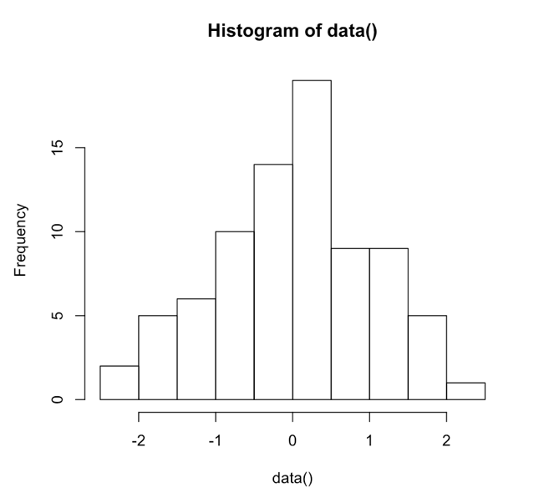
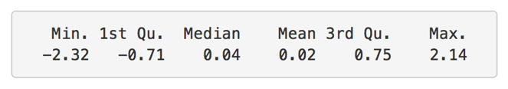
input$num
data <- reactive({ rnorm(input$num)
})
output$hist <-
renderPlot({ hist(data())
})
output$stats <- renderPrint({ summary(data())
})

Slide 62
A reactive expression is special in two ways
Slides at: bit.ly/shiny-quickstart-2
data()
1
2
You call a reactive expression like a function
Reactive expressions cache their values (the expression will return its most recent value, unless it has become invalidated)

Slide 63
Recap: reactive()
Slides at: bit.ly/shiny-quickstart-2
reactive() makes an object to use (in downstream code)
data <- reactive({ rnorm(input$num)
})
input$num
Reactive expressions are themselves reactive. Use them to modularize your apps.
data <- reactive({ rnorm(input$num)
})
output$hist <- renderPlot({
hist(data())
})
output$stats <- renderPrint({ summary(data())
})
data()
Call a reactive expression like a function
2
Reactive expressions cache their values to avoid unnecessary computation

Slide 64
Prevent reactions with isolate()

Slide 65
Can we prevent
# 01-two-inputs
library(shiny)
the title field from
ui <- fluidPage( sliderInput(inputId = "num",
label = "Choose a number",
updating the plot?
value = 25, min = 1, max = 100), textInput(inputId = "title",
label = "Write a title",
value = "Histogram of Random Normal Values"), plotOutput("hist")
)
server <- function(input, output) { output$hist <- renderPlot({
hist(rnorm(input$num), main = input$title)
})
}
shinyApp(ui = ui, server = server)

Slide 66
isolate()
Slides at: bit.ly/shiny-quickstart-2
Returns the result as a non-reactive value
isolate({ rnorm(input$num) })
object will NOT respond to any reactive value in the code
code used to build object

Slide 67
# 01-two-inputs
library(shiny) ui <- fluidPage(
sliderInput(inputId = "num", label = "Choose a number",
value = 25, min = 1, max = 100), textInput(inputId = "title",
label = "Write a title",
value = "Histogram of Random Normal Values"), plotOutput("hist")
)
server <- function(input, output) { output$hist <- renderPlot({
hist(rnorm(input$num), main = input$title)
})
}
shinyApp(ui = ui, server = server)

Slide 68
# 04-isolate
library(shiny) ui <- fluidPage(
sliderInput(inputId = "num", label = "Choose a number",
value = 25, min = 1, max = 100), textInput(inputId = "title",
label = "Write a title",
value = "Histogram of Random Normal Values"), plotOutput("hist")
)
server <- function(input, output) { output$hist <- renderPlot({
hist(rnorm(input$num),
main = isolate({input$title}))
})
}
shinyApp(ui = ui, server = server)

Slide 69
input$num
input$title
○
output$hist <- renderPlot({ hist(rnorm(input$num),
main = isolate(input$title))
})

Slide 70
input$num
input$title
output$hist <- renderPlot({ hist(rnorm(input$num),
main = isolate(input$title))
})

Slide 71
input$num
input$title
output$hist <- renderPlot({ hist(rnorm(input$num),
main = isolate(input$title))
})

Slide 72
Recap: isolate()
Slides at: bit.ly/shiny-quickstart-2
○
isolate() makes an non-reactive object
$
Use isolate() to treat reactive values like normal R values

Slide 73
Trigger code
with observeEvent()

Slide 74
Slides at: bit.ly/shiny-quickstart-2
input$x
expression(o)utput$y

Slide 75
Slides at: bit.ly/shiny-quickstart-2
run(this)
input$x
expression()
output$y

Slide 76
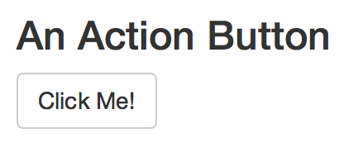
Action buttons
Slides at: bit.ly/shiny-quickstart-2
input function
input name
(for internal use)
label to display
actionButton(inputId = "go", label = "Click Me!")
Notice: Id not ID
© 2015 RStudio, Inc. All rights reserved.

Slide 77
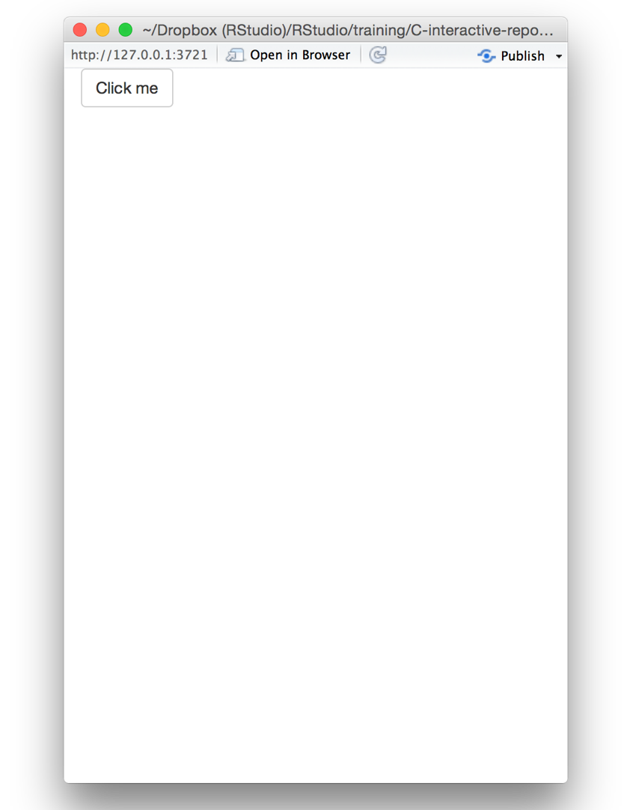
# 05-actionButton
library(shiny)
ui <- fluidPage(
actionButton(inputId = "clicks", label = "Click me")
)
server <- function(input, output) {
}
shinyApp(ui = ui, server = server)

Slide 78
observeEvent()
Slides at: bit.ly/shiny-quickstart-2
Triggers code to run on server
observeEvent(input$clicks, { print(input$clicks) })
reactive value(s) to respond to
code block to run whenever observer is invalidated
note: observer treats this code as if it has been isolated with isolate()
(observer invalidates ONLY when this value changes)

Slide 79
# 05-actionButton
library(shiny)
ui <- fluidPage(
actionButton(inputId = "clicks", label = "Click me")
)
server <- function(input, output) {
observeEvent(input$clicks, { print(as.numeric(input$clicks))
})
}
shinyApp(ui = ui, server = server)

Slide 80
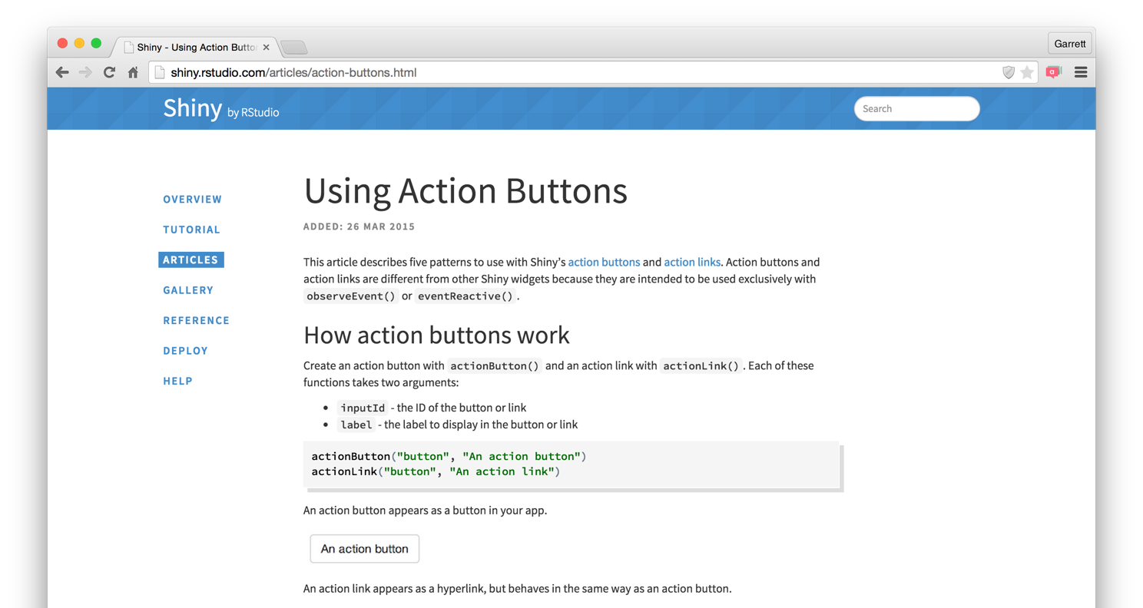
Slides at: bit.ly/shiny-quickstart-2
Action buttons article
http://shiny.rstudio.com/articles/action-buttons.html

Slide 81
observe()
Slides at: bit.ly/shiny-quickstart-2
Also triggers code to run on server.
Uses same syntax as render*(), reactive(), and isolate()
observe({ print(input$clicks) })
observer will respond to every reactive value in the code
code block to run whenever observer is invalidated

Slide 82
Slides at: bit.ly/shiny-quickstart-2
Recap: observeEvent()
observeEvent() triggers code to run on the server
Specify precisely which reactive values should invalidate the observer
observeEvent(input$clicks, { print(input$clicks) })
reactive value(s) to respond to
observe()
Use observe() for a more implicit syntax

Slide 83
Delay reactions
with eventReactive()

Slide 84
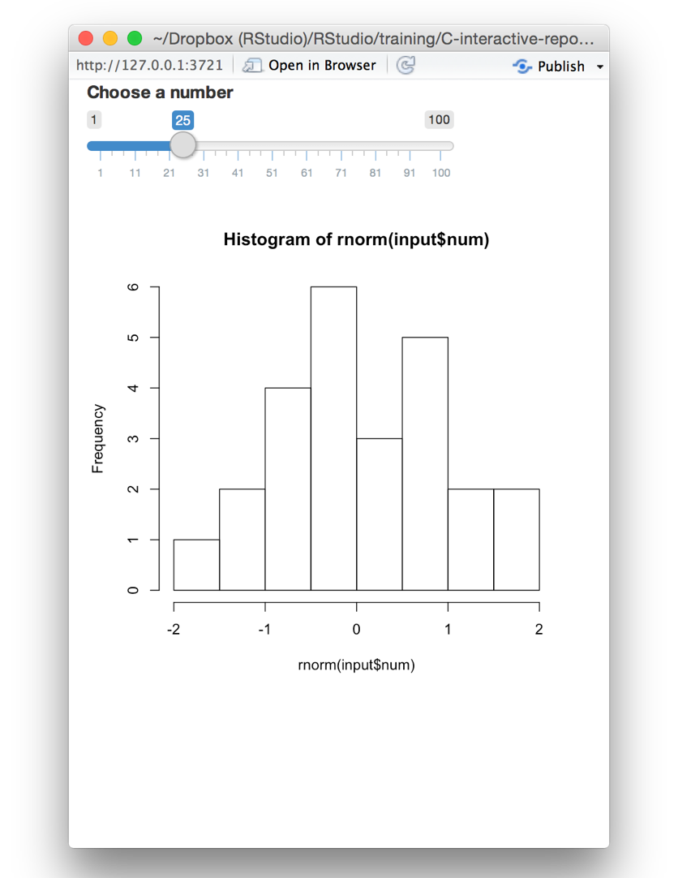
# 07-eventReactive
library(shiny) ui <- fluidPage(
sliderInput(inputId = "num", label = "Choose a number",
value = 25, min = 1, max = 100),
plotOutput("hist")
)
server <- function(input, output) {
output$hist <- renderPlot({ hist(rnorm(input$num))
})
}
shinyApp(ui = ui, server = server)

Slide 85
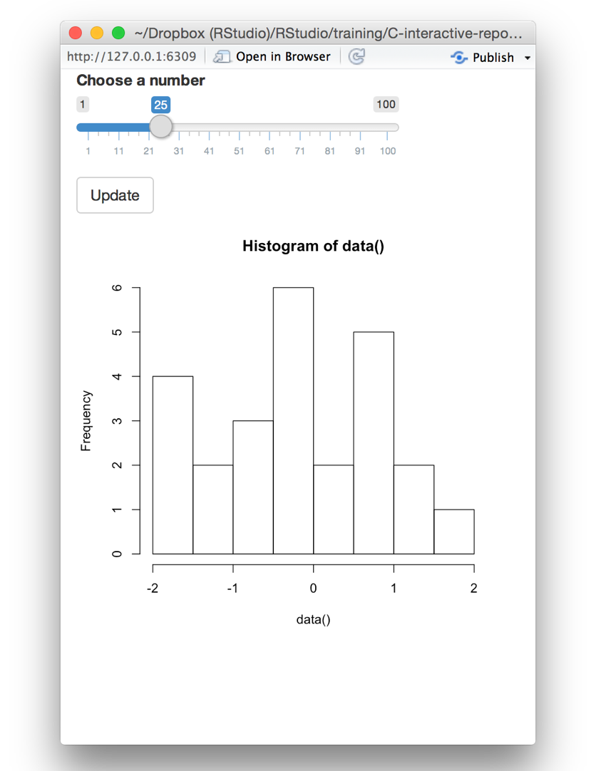
Can we prevent the
# 07-eventReactive
graph from updating
library(shiny)
until we hit the button?
ui <- fluidPage( sliderInput(inputId = "num",
label = "Choose a number",
value = 25, min = 1, max = 100),
actionButton(inputId = "go", label = "Update"),
plotOutput("hist")
)
server <- function(input, output) {
output$hist <- renderPlot({ hist(rnorm(input$num))
})
}
shinyApp(ui = ui, server = server)

Slide 86
eventReactive()
Slides at: bit.ly/shiny-quickstart-2
A reactive expression that only responds to specific values
data <- eventReactive(input$go, { rnorm(input$num) })
reactive value(s) to respond to
code used to build (and rebuild) object
note: expression treats this code as if it has been isolated with isolate()
(expression invalidates ONLY when this value changes)

Slide 87
# 07-eventReactive
library(shiny) ui <- fluidPage(
sliderInput(inputId = "num", label = "Choose a number",
value = 25, min = 1, max = 100), actionButton(inputId = "go",
label = "Update"), plotOutput("hist")
)
server <- function(input, output) {
output$hist <- renderPlot({ hist(rnorm(input$num))
})
}
shinyApp(ui = ui, server = server)

Slide 88
# 07-eventReactive
library(shiny) ui <- fluidPage(
sliderInput(inputId = "num", label = "Choose a number",
value = 25, min = 1, max = 100), actionButton(inputId = "go",
label = "Update"), plotOutput("hist")
)
server <- function(input, output) {
data <- eventReactive(input$go, {
})
output$hist <- renderPlot({ hist(rnorm(input$num))
})
}
shinyApp(ui = ui, server = server)

Slide 89
# 07-eventReactive
library(shiny) ui <- fluidPage(
sliderInput(inputId = "num", label = "Choose a number",
value = 25, min = 1, max = 100), actionButton(inputId = "go",
label = "Update"), plotOutput("hist")
)
server <- function(input, output) {
data <- eventReactive(input$go, {
})
output$hist <- renderPlot({ hist(rnorm(input$num))
})
}
shinyApp(ui = ui, server = server)

Slide 90
# 07-eventReactive
library(shiny) ui <- fluidPage(
sliderInput(inputId = "num", label = "Choose a number",
value = 25, min = 1, max = 100), actionButton(inputId = "go",
label = "Update"), plotOutput("hist")
)
server <- function(input, output) {
data <- eventReactive(input$go, { rnorm(input$num)
})
output$hist <- renderPlot({ hist(rnorm(input$num))
})
}
shinyApp(ui = ui, server = server)

Slide 91
# 07-eventReactive
library(shiny) ui <- fluidPage(
sliderInput(inputId = "num", label = "Choose a number",
value = 25, min = 1, max = 100), actionButton(inputId = "go",
label = "Update"), plotOutput("hist")
)
server <- function(input, output) {
data <- eventReactive(input$go, { rnorm(input$num)
})
output$hist <- renderPlot({ hist(data())
})
}
shinyApp(ui = ui, server = server)

Slide 92
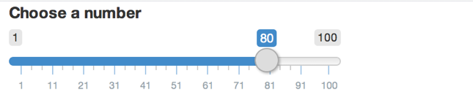

input$go
input$num
data <- eventReactive(input$go, { rnorm(input$num)
})
output$hist <- renderPlot({
hist(data())
})
© 2015 RStudio, Inc. All rights reserved.

Slide 93
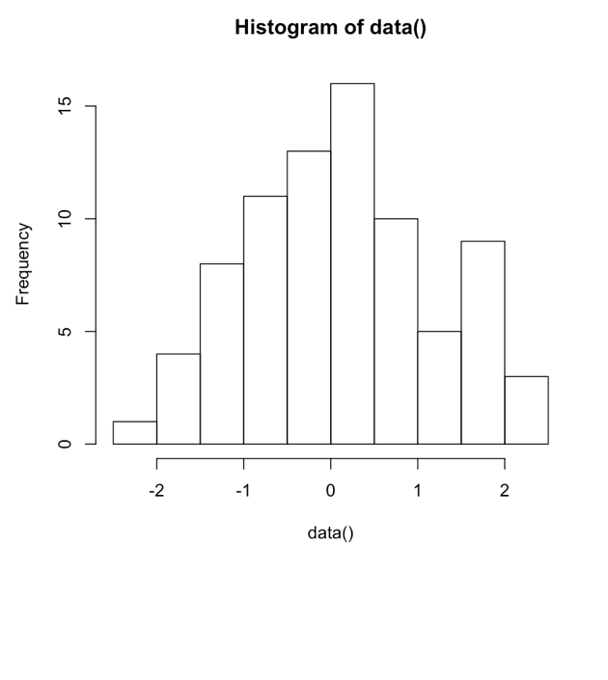
input$go
input$num
data <- eventReactive(input$go, { rnorm(input$num)
})
output$hist <- renderPlot({
hist(data())
})
© 2015 RStudio, Inc. All rights reserved.

Slide 94

Slides at: bit.ly/shiny-quickstart-2
Recap: eventReactive()
Update
Use eventReactive() to delay reactions
data()
eventReactive() creates a reactive expression
You can specify precisely which reactive values should invalidate the expression
eventReactive(input$go, { rnorm(input$num) })
reactive value(s) to respond to
© CC 2015 RStudio, Inc.

Slide 95
Manage state
with reactiveValues()

Slide 96
Slides at: bit.ly/shiny-quickstart-2
Input values
The input value changes whenever a user changes the input.
input$num = 25
input$num = 50
ou cannot set these
values in your code
input$num = 75
Y
© 2015 RStudio, Inc. All rights reserved.

Slide 97
reactiveValues()
Slides at: bit.ly/shiny-quickstart-2
Creates a list of reactive values to manipulate programmatically
rv <- reactiveValues(data = rnorm(100))
(optional) elements to add to the list

Slide 98
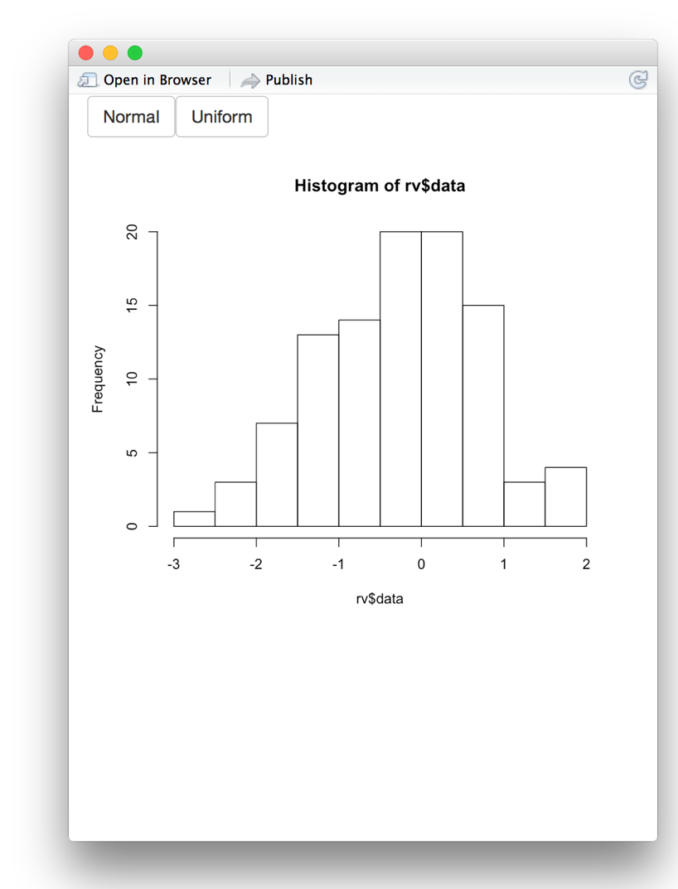
# 08-reactiveValues
library(shiny) ui <- fluidPage(
actionButton(inputId = "norm", label = "Normal"), actionButton(inputId = "unif", label = "Uniform"), plotOutput("hist")
)
server <- function(input, output) {
rv <- reactiveValues(data = rnorm(100))
observeEvent(input$norm, | { | rv$data | <- | rnorm(100) | })
observeEvent(input$unif, | { | rv$data | <- | runif(100) | })
output$hist <- renderPlot({ hist(rv$data)
})
}
shinyApp(ui = ui, server = server)

Slide 99
input$norm
rv$data rnorm(100)
input$unif
output$hist <- renderPlot({
hist(rv$data)
})
© 2015 RStudio, Inc. All rights reserved.

Slide 100
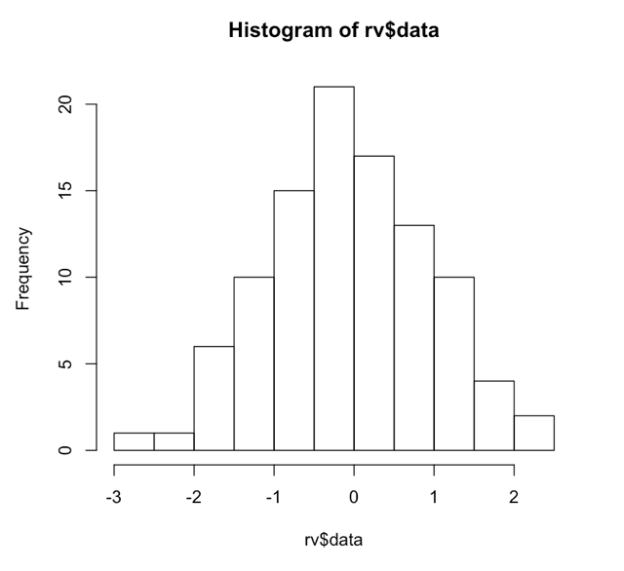
input$norm
rv$data rnorm(100)
input$unif
output$hist <- renderPlot({
hist(rv$data)
})
© 2015 RStudio, Inc. All rights reserved.

Slide 101
input$norm
rv$data ruonrimf(100)
input$unif
output$hist <- renderPlot({
hist(rv$data)
})
© 2015 RStudio, Inc. All rights reserved.

Slide 102
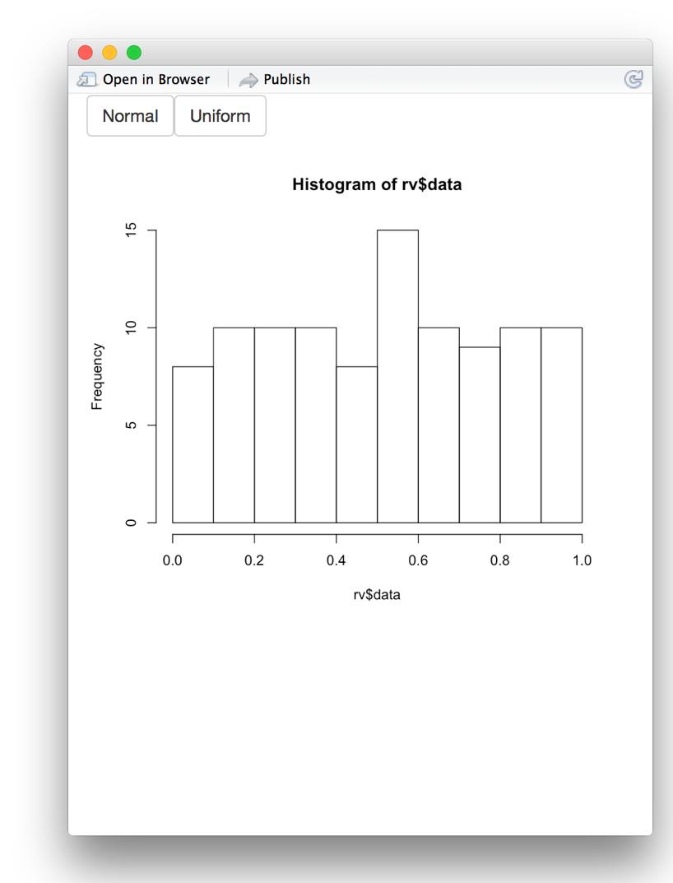
input$norm
rv$data runif(100)
input$unif
output$hist <- renderPlot({
hist(rv$data)
})
© 2015 RStudio, Inc. All rights reserved.

Slide 103
# 08-reactiveValues
library(shiny) ui <- fluidPage(
actionButton(inputId = "norm", label = "Normal"), actionButton(inputId = "unif", label = "Uniform"), plotOutput("hist")
)
server <- function(input, output) {
rv <- reactiveValues(data = rnorm(100))
observeEvent(input$norm, | { | rv$data | <- | rnorm(100) | })
observeEvent(input$unif, | { | rv$data | <- | runif(100) | })
output$hist <- renderPlot({ hist(rv$data)
})
}
shinyApp(ui = ui, server = server)

Slide 104
# 08-reactiveValues
library(shiny) ui <- fluidPage(
actionButton(inputId = "norm", label = "Normal"), actionButton(inputId = "unif", label = "Uniform"), plotOutput("hist")
)
server <- function(input, output) {
rv <- reactiveValues(data = rnorm(100))
observeEvent(input$norm, | { | rv$data | <- | rnorm(100) | })
observeEvent(input$unif, | { | rv$data | <- | runif(100) | })
output$hist <- renderPlot({ hist(rv$data)
})
}
shinyApp(ui = ui, server = server)

Slide 105


Slides at: bit.ly/shiny-quickstart-2
Recap: reactiveValues()
reactiveValues() creates a list of reactive values
You can manipulate these values (usually with observeEvent())
rv$data <-

Slide 106

Slides at: bit.ly/shiny-quickstart-2
You now know how to
Modularize
Trigger arbitrary code
observeEvent() observe()
run(this)
reactions
reactive()
Prevent reactions
isolate()
input$x
expression()
output$y
Create your own reactive values reactiveValues()
Render reactive output render*()
Update
Delay reactions
eventReactive()

Slide 107
Parting
tips

Slide 108













Application
Instance
Instance
Worker
Worker
Worker
Worker
Worker
Connections (End users)
Connections (End users)
Connections (End users)
Connections (End users)

Slide 109
Reduce repetition
Slides at: bit.ly/shiny-quickstart-2
Place code where it will be re-run as little as necessary
library(shiny)
ui <- fluidPage(
sliderInput(inputId = "num", label = "Choose a number", value = 25, min = 1, max = 100),
plotOutput("hist")
)
Code outside the server function will be run once per R session (worker)
Code inside the server function will be run once per end user (connection)
server <- function(input, output) {
output$hist <- renderPlot({ hist(rnorm(input$num))
})
Code inside a reactive function will be run once per reaction
(e.g. many times)
}
shinyApp(ui = ui, server = server)

Slide 110
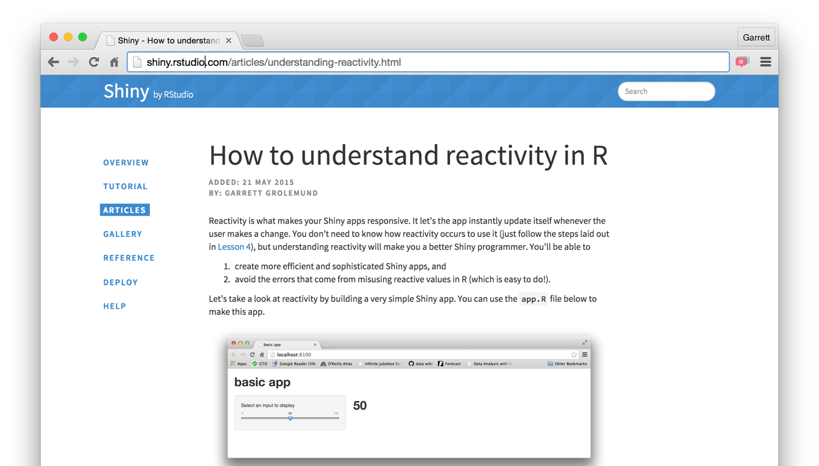
Slides at: bit.ly/shiny-quickstart-2
How can R possibly implement reactivity?
http://shiny.rstudio.com/articles/understanding-reactivity.html

Slide 111
Learn more

Slide 112
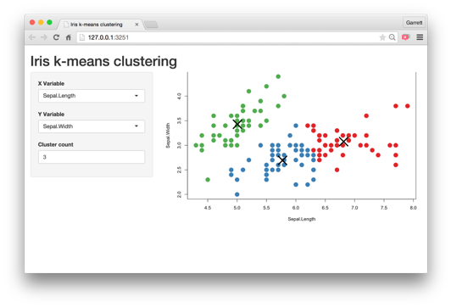
Slides at: bit.ly/shiny-quickstart-2
How to start with Shiny
1. How to build a Shiny app (www.rstudio.com/resources/webinars/)
2. How to customize reactions (Today)
3. How to customize appearance (June 17)

Slide 113

The Shiny Development Center
shiny.rstudio.com
Slides at: bit.ly/shiny-quickstart-2

